Slide 1
UGANDA’S ROAD TO INDEPENDENCE 9TH OCTOBER 2022
60
YEARS
COUNT DOWN 22 DAYS

Slide 2
THESE ARE THE NEWS BULLETIN
NATIONAL NEWS
INTERNATIONAL NEWS
SPORTS NEWS
GRADING OF THE WEEK
QUOTE OF THE WEEK
BY: JACKIE NALUKOWE
AND BAZUBAGIRA BEATRICE

Slide 3
NATIONAL NEWS UGANDA PARLIAMENT PASSES THE COMPUTER MISUSES BILL 2O22
THE UGANDAN PARLIAMENT ON THURSDAY 8TH SEPTEMBER 2022 AMMENDED AND PASSED THE COMPUTER MISUSE ACT WHICH REGULATED IDEAS AND INFORMATION ON THE INTERNET . THE IDEA HAS BEEN DESCRIBED AS POLITICAL SINCE IT CENSORS THE PRESS AND PUTS THE FREEDOM OF EXPRESSION AND PARTICIPATORY AT STAKE. THE FOLLOWING ARE TO BE DECLARED CRIMES IF AT ALL THE PRESIDENT APPROVES THE BILL

Slide 4
. THE FOLLOWING ARE TO BE DECLARED CRIMES IF AT ALL THE PRESIDENT APPROVES THE BILL
ONLINE HARRASMENT
TRIBALISTIC MESSAGES
DISCRIMINATION MESSAGES
HATE SPEECH
FALSE INFORMATION
USE OF SOMEONE’S PERSONAL INFORMATION WITHOUT HIS APPROVAL
DISTIBUTION OF CHILD PORNOGRAPHY
MALICIOUS INFORMATION
HACKING AND OTHER COMPUTER CRIMES
NB. MOST OF ALL IT IS NOW A CRIME TO SCREEN SHOOT A CONVERSATION BETWEEN TWO PEOPLE AND POST IT ONLINE.WHATSAPPERS AT RISK, LETS WAIT FOR THE PRESIDENT APPROVAL OR DISAPPROVAL.

Slide 6
INTERNATIONAL NEWS. QUEEN OF ENGLAND LAID TO REST.
Her Majesty The Late Queen of England is to be laid to rest today. She died at the age of 96 having ruled England for 70 years. Royal family members have historically been buried at ST. GEORGE’S CHAPEL at Windsor since the 19th century, May Her soul rest in eternal peace.

Slide 8
SPORT NEWS. ARSENAL (ZAKAYO) ON TOP.
Despite being dropped to the third position Saturday night, Sunday afternoon Arsenal claimed it’s proclaimed position. Arsenal is now the first in the premier League after a 3 to nil win against Brentford which had defeated Man U with 4 goals to nil at the start of the season. Arsenal goals were scored by William Saliba, Gabriel Jesus and Fabio Viera.

Slide 10
More to EPL last weekend, Newcastle drew with Bournemouth one to one, Mancity defeated Wolves with 3goals to nil. These were scored by Grealish, Foden and Harland. Tottenham beat Leicester 6 goals to two with son coming off the bench in the second half to score hatrick. Everton also beat Westham 1 goal to nil.

Slide 11
Arsenal is therefore topping the table, Mancity in the 2nd position, spurs in the 3rd , Brighton in the 4th and Man U in the 5th position. Harland is topping the goal scorers.

Slide 12
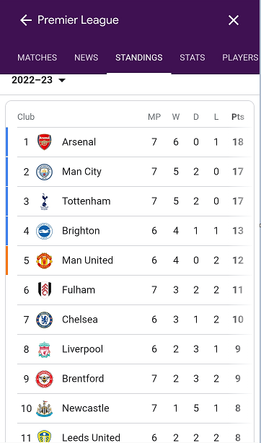

Slide 13
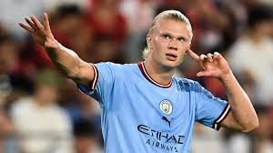
EPL TOP SCORERS
ERLING HAALAND- MAN CITY- 11 GOALS

Slide 14
GRADING OF THE WEEK RWENZORI
RWENZORI 1 | RWENZORI 2 | RWENZORI 3
SENSOR F.3 | ATWIJUKIRE SEIZE F.5 S | PHILLIP MUJURIZI F.2
NIWAMANYA ONAN F.5 A | ABAHO AMON F.5 S | CEASAR BLESSING F.6
. MOROTO
MOROTO 1 | MOROTO 2
YORAM ORIHO F.2 | NUWENGIRA BLAIR
BAFAKI ERIAB F.1 | MARK NINSIIMA F.5 S

Slide 15
KIRIMANJARO
KILIMANJARO 1 | KILIMANJARO 2
KAYESU MARGRET F.2 | MURUNGI ENID F.4
AINEMBABAZI CATHERINE F.2 | MARY ADELLA F.4
. ELGON
ELGON 1 | ELGON 2
PRAISE AKANKUNDA F.4 | DAPHINE NASASIRA F.5
NUWARINDA LIZ F.2 | ORISHABA ANGELLA KAMATENESI HOPE

Slide 16
SMARTEST IN UNIFORM SMARTEST IN CASUAL
GIRLS GIRLS
NANKYA MICHELLE F.5 HONEST F.2
QUEEN ELIZABETH F.4 MAURICIA F.4
BOYS BOYS
MUGAIGA EARNEST F.1 NINSIIMA MARK F.5
MWEBAZE FRANK F.5 SHIVAN F.4

Slide 17
QUOTE OF THE WEEK
IF YOU ARE NOT BRAVE ENOUGH, NO ONE WILL BACK YOU UP

